Slide 1
PREDICTIVE MODELING FOR TERM DEPOSIT SUBSCRIPTION
Objective: Predict clients likely to subscribe to a term deposit using demographic and behavioral data.
Bank Dataset: 1 target variable (y) and 16 features, comprising a mixture of numeric and categorical variables.
Data Exploration
Preprocessing
Modeling
Evaluation
Insights
THE WORKFLOW

Slide 2
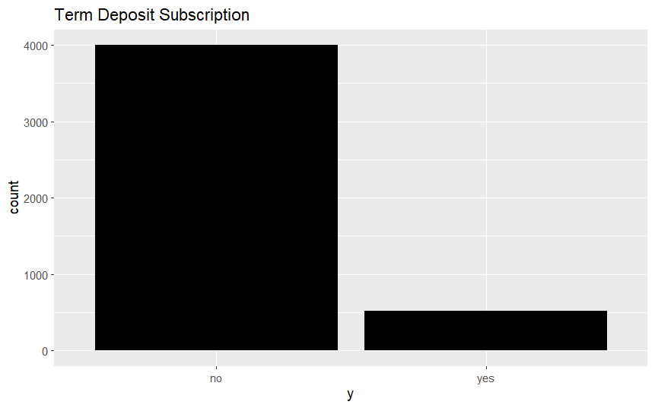
DATA EXPLORATION & PREPROCESSING
Key Observations:
Class imbalance: 88% “no”, 12% “yes”
Missing values: Job (8.4%), Education (4.14%), Contact (29%), Poutcome (82%)
Weak individual correlations between features
Preprocessing Steps:
Removed duplicates
Imputed missing values using MICE
Scaled numeric variables
Recoded pdays (-1 converted to “No Previous Contact”)
Train/test split (80/20)

Slide 3
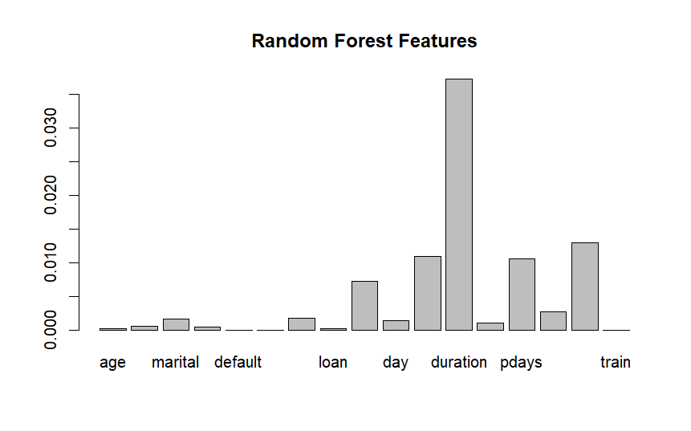
MODELING APPROACHES
Logistic Regression:
Binary outcome, interpretable coefficients
Useful for decision-making insights
Random Forest:
Handles mixed feature types, robust to noise
Provides feature importance
Key Predictors: Call duration, previous campaign outcome (poutcome), recency of contact (pdays), month of contact

Slide 4
MODEL RESULTS & EVALUATION
Both models faced challenges in detecting subscribers due to class imbalance
Logistic Regression: slightly higher accuracy and interpretability
Random Forest: useful for feature insights
Metric | Logistic Regression | Random Forest
Accuracy | 90.39% | 89.54%
Sensitivity | 33.65% | 30.84%
Specificity | 97.71% | 97.11%
Balanced Accuracy | 65.68% | 63.97%

Slide 5
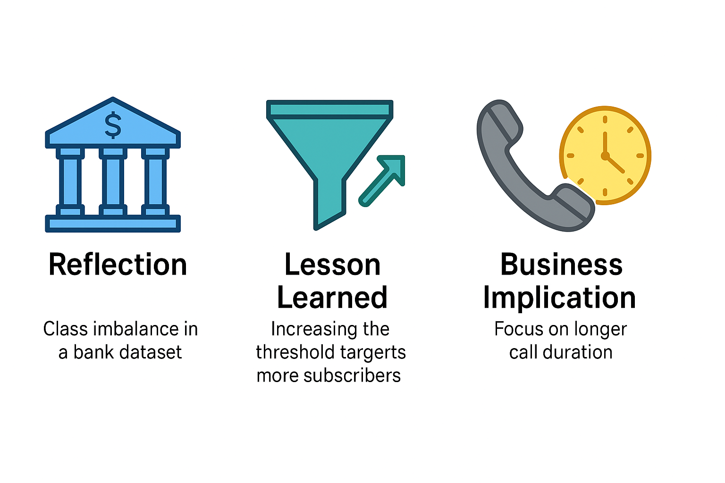

REFLECTION, LESSONS LEARNED & BUSINESS IMPLICATIONS
Reflection & Lessons Learned:
Class imbalance is a key challenge in marketing datasets
Preprocessing (imputation, scaling) is crucial for model performance
Logistic Regression is valuable for interpretability; Random Forest for feature importance
Business Implications:
Focus marketing on clients with long calls, positive previous outcomes, recent contact
Future Improvements:
Threshold tuning to enhance sensitivity for subscribers

